Slide 1

AM Geoconsult and Associates, Inc. Business Process Automation
Presentation by
EVERETT GAIUS S. VERGARA
Chief Technical Officer
FYDesigns, Inc.
07 February 2020

Slide 2
objectives

Slide 3
Automation Process
Objectives:
Organization of Forms
Enforcement of Approval
Accountability
Reporting
Human Resources
Inventory
Finance
Project

Slide 4
Getting started with the system

Slide 5
User
A User is an AMGEO Employee, AMGEO Management, FYDesigns Support / Developer
Each AMGEO employee will have their own USER and Password
Your User Name is your First Name + First letter of your last name:
Employee Name: Everett Vergara
User Name: everettV
Password: amgeo (default)

Slide 6
Modules
A module is a data entry form, system configuration, report and/or printout that can be accessed by any authorized user of the system
Some examples of module are the following:
User Access
Boring Logs
Short Purchase Order
Stockcard Report
Item Balance
And many more

Slide 7
User Access
Each user will have a User Access assignment to determine the modules that can be used
The standard User Access is defined as:
AMGEO can add more User Access as deemed necessary.
Each Department will have their own set of accessible modules
Department
Staff
Department
Manager
Management

Slide 8
Sample User Access Rights
HR
Staff
HR
Manager
Management
Employee Master
SSS
Pagibig
Philhealth
Etc...
Full Access to HR Staff Modules
Employee Master with Salary
Full Access to all Modules
Important: AMGEO needs to assign User Access Types per Module. The default User Access Privilege for all users is set to access all modules

Slide 9
Approval Matrix
All transactions can be setup to go thru an approval process
The default approval matrix is setup as follows
Once a record is forwarded for approval, the approver will be notified thru the Reminder Window
Department
Staff
Department
Manager
Department
Manager
Management

Slide 10
Approval Process
Active / New
Note: Super Users / Management overrides approval of any approvers
Forwarded For Approval #1
Forwarded For Approval #2
(Optional)
Forwarded For Approval #3
(Optional)
Disapproved / Cancelled
Approved

Slide 11

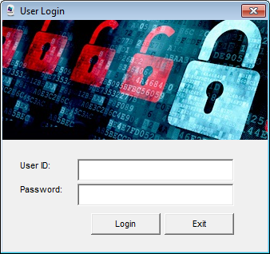
User Login
From the desktop Double Click the FYDesigns icon
Enter your given user ID and password
Sample
User ID: chesterD
Password: amgeo

Slide 12

System Update
Like any other App. FYDesigns System needs patching to correct bugs, address new requirements and upgrade.
If you’re prompted:
“The version of your application is not compatible....” Simply Update the System by double clicking the Updater Icon
Important: Make sure to close the system before updating the app

Slide 13
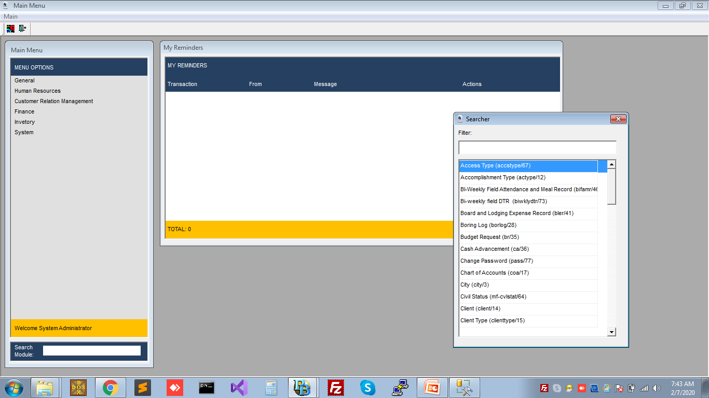
Main Menu
The Main menu lists all the possible Modules that you can access defined in your Access Rights

Slide 14
Module Searcher
Module searcher allows you to find what you’re looking for quickly.
You can press Ctrl + F to type keywords of the module.
Pressing Ctrl + F will pop-up the searcher window and you can begin typing for keywords >>>>>>>>>>>>>>>>

Slide 15
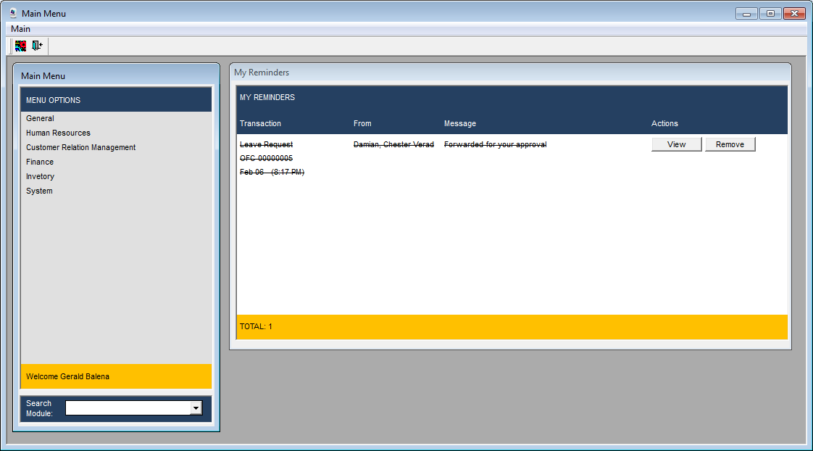
Reminders
You get reminders when:
The transaction you created gets disapproved / cancelled
The transaction you created gets approved / posted
Your subordinate submitted a transaction for your approval
The texts are struckthrough after viewing a reminder.
Click the remove button to remove it from the list.

Slide 16
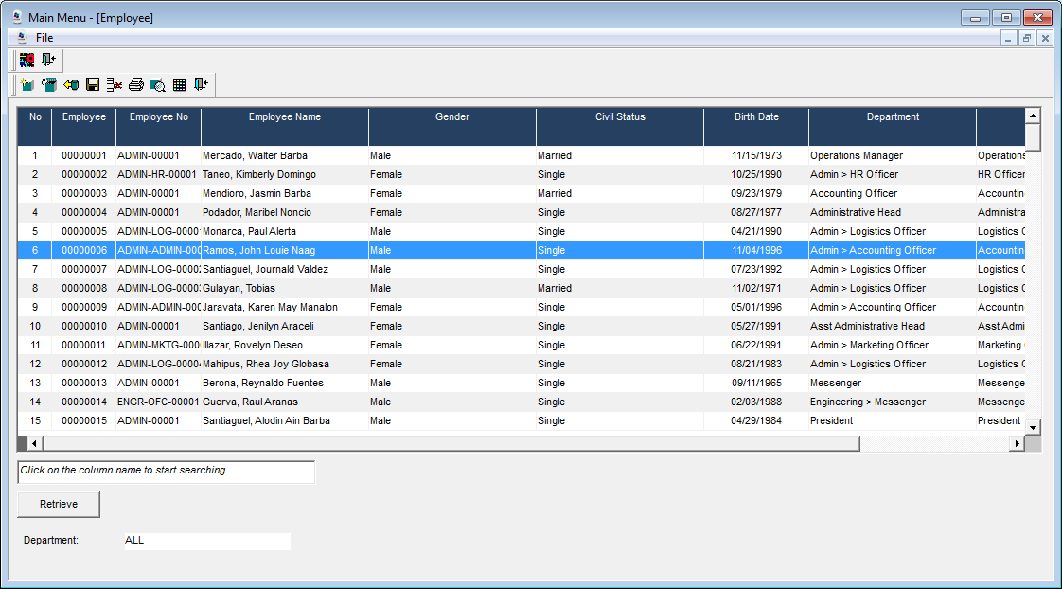
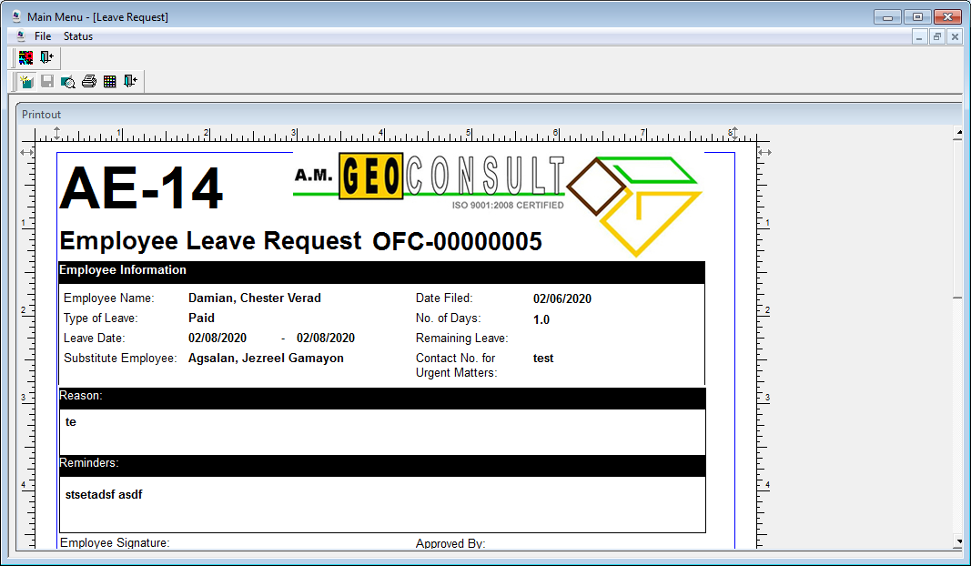
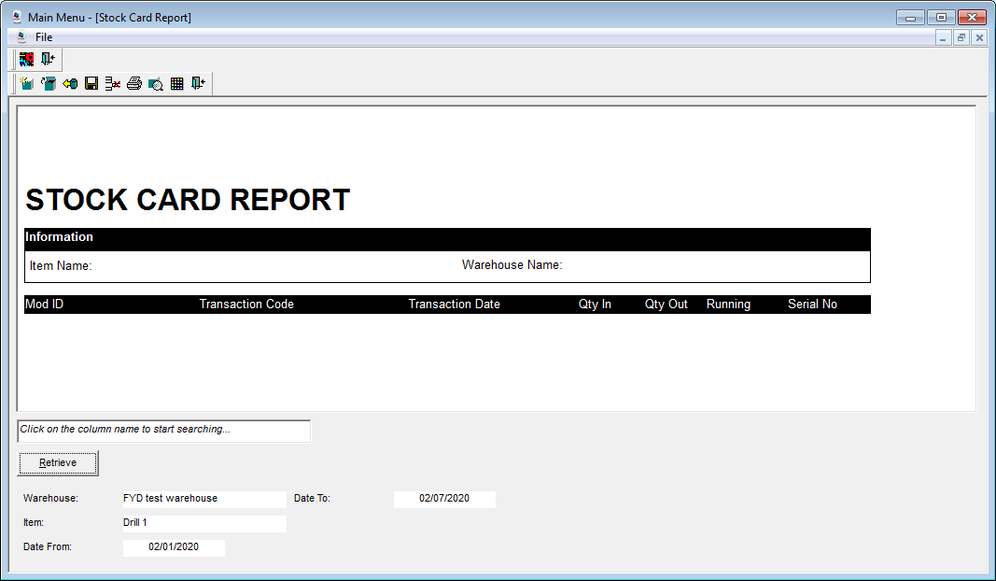
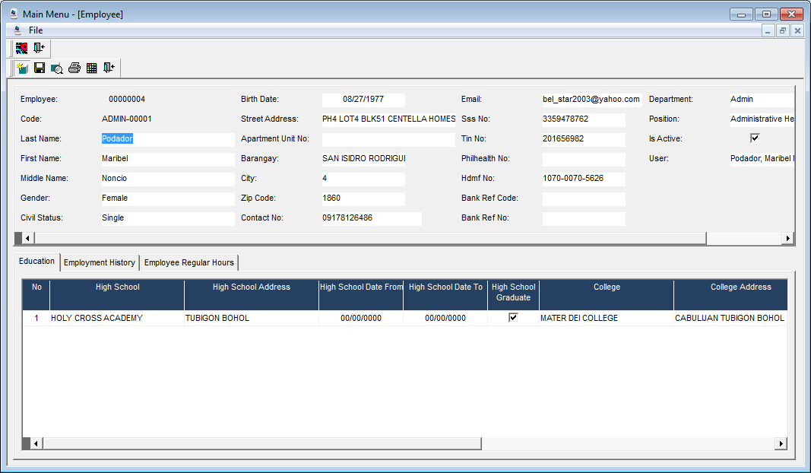
The Standard Module

Slide 17
The Row Manager
App Version
Program Exit

Slide 18
The Row Manager
New Record
Edit / Open Record
Retrieve
Save
Delete
Print
Print Preview
Print Settings
Module Exit

Slide 19
The Row Manager
List of records created
Click on the columns to sort
Click on the column to search
Double click to open / edit the selected record
Ctrl + Click to select multiple rows
Ctrl + A to select all rows

Slide 20
The Row Manager
This area allows you to find text from the selected (clicked) column based on the list of records retrieved

Slide 21
The Row Manager
Allows the user to filter records to be retrieved for the Rowmanager. Filter criteria vary depending on the module.
The retrieve button retrieves the records based on the selected criteria / criterion.

Slide 22
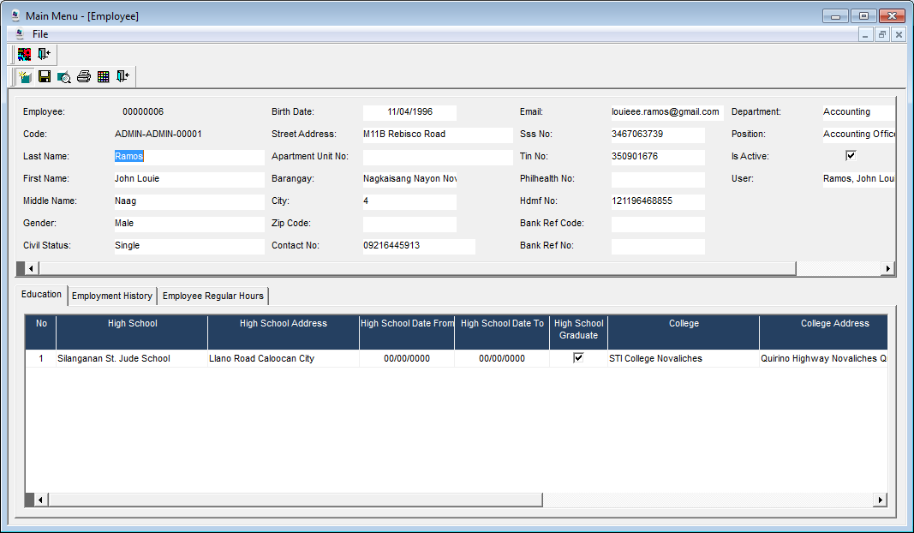
The Data Entry
New
Save
Print Preview
Print
Print Setup
Exit

Slide 23
The Data Entry
Entry section where user inputs the necessary data for recording.
Fields vary per module.

Slide 24
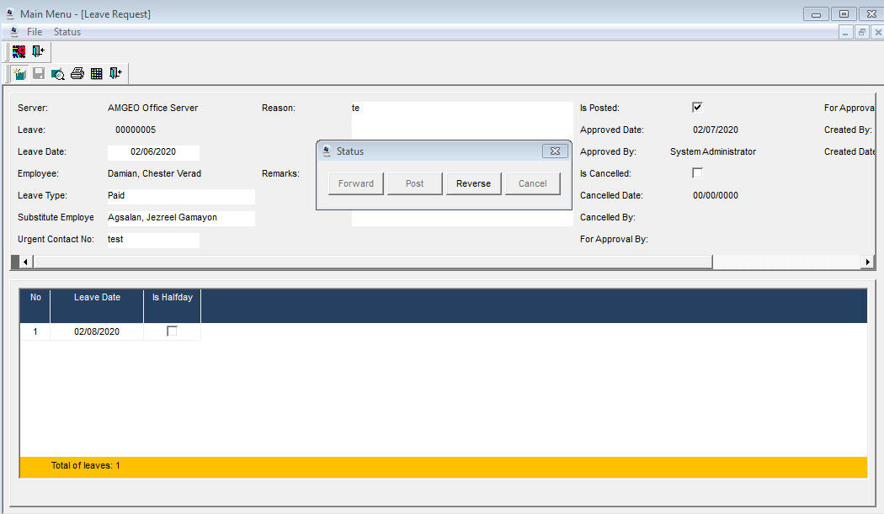
The Data Entry - Status
Clicking the status menu will pop-up the status dialog box.
Forward – Sends this record to the next approver
Post – Approves / Posts this record (only if you’re a super user or the last approver)
Reverse – Brings back the document to active / new status
Cancel – Cancels / Disapproves the record

Slide 25
The Printout
Printout corresponds to the record opened in the data entry.
For control purposes, Only posted records can be printed

Slide 26
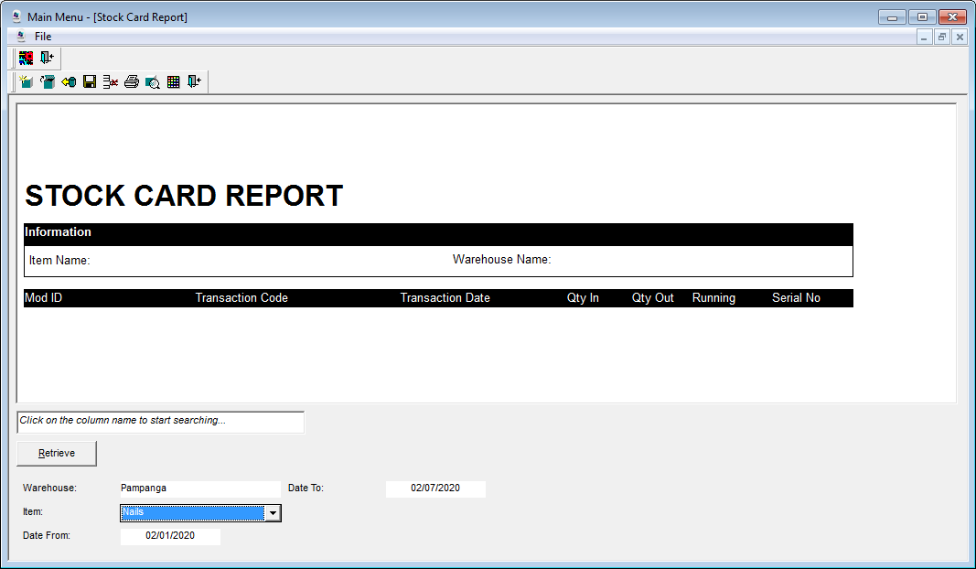
The Report
Reports have basically the same buttons, functions and retrieval filters as the Row Manager.

Slide 27
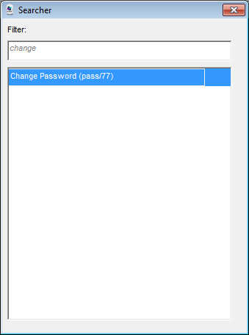
Securing Your Account
Your first task before anything else is changing your default password.
Find the Change Password Module and Change your password

Slide 28
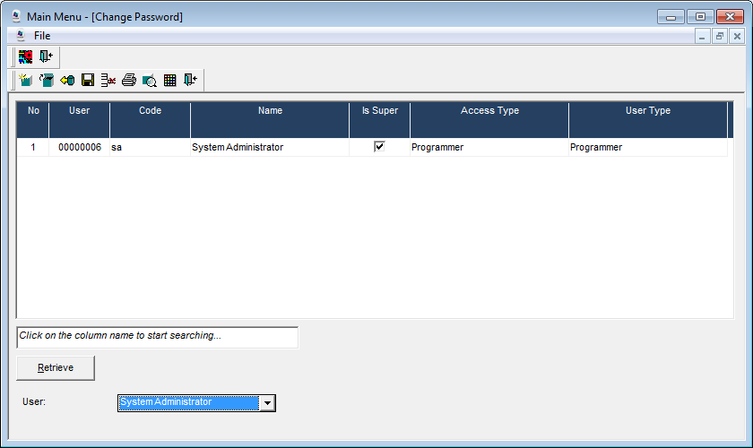
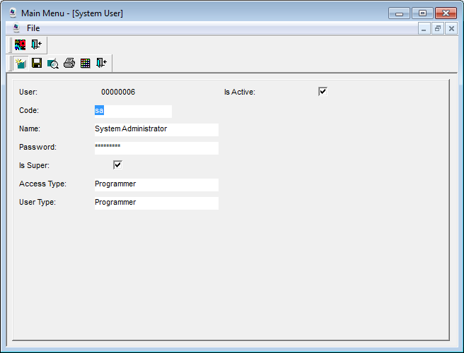
Securing Your Account
Double click on the user via the row manager
Type your new Password and Save.
Exit the program and try to login using the new password

Slide 29
modules

Slide 30
HR Modules
Employee Master
Profile
Salary
Team
Position
Department
SSS
Pagibig
Philhealth
Etc...
Transactions and Reports
Overtime Logs
Leave Requests
Bi-Weekly DTR
Time and Attendance Extract
Field Personnel
DTR

Slide 31
Project Modules
Project
Boring Logs
Other Accomplishments
Team Daily Accomplishments

Slide 32
Inventory Modules
Transactions
Stock Adjustments
Beginning Balance
For Destruction
Missing
Add / Found
Receiving
Others
Item Transfers
Out / In
Master Files
Items
Unit
Item Group
Warehouse

Slide 33
Finance
Transactions
Short PO
Budget Request
Cash Advance
Transfer of Funds
Source of Funds
Damage / Lost Item Record
Repair and Maintenance
Transactions
Board and Lodging
Temporary Field Employee
Employee Travel Log Expense
Liquidation of Expense
Bi-Weekly Field Attendance and Meal Record

Slide 34
ACTUAL DEMO STARTS NOW

Slide 35
Thank you

